Slide 1
TechExcel: Implementing DevOps practices to accelerate developer productivity
Day One
Notes:
Important notes:
Links to lab/exercises on GitHub
https://github.com/microsoft/TechExcel-Implementing-DevOps-practices-to-accelerate-developer-productivity-code
https://github.com/microsoft/TechExcel-Implementing-DevOps-practices-to-accelerate-developer-productivity
Hybrid subscription WIKI Hybrid Subscription - Overview (azure.com)

Slide 2
Exercise one
Set up development environment
Notes:
Speaker’s notes:
SAY:
Before we proceed to the different lab exercises, let’s look at the following section which covers common challenges you may expect or experience during the exercises.
The details and information will provide more technical depth and context for specific tasks you may not have done or performed before.
This discussion gives you a forum to clarify things and ask questions.

Slide 3









Create the components for Dev Box
Managed Identity
Virtual Network
SKU(s)
Dev Center
Dev Box Definition(s)
Image
Network Connection
Project(s)
Compute Gallery
Dev Box(es)
Pool(s)
Notes:
Speaker’s Notes: (From the slide previous to this one, might be relevant for this slide)
Dev box creation starts with three core components—a Dev center to act as the hub for managing dev box components across projects, preconfigured network connections to best serve developers in any region, and dev box definitions that bring together a Windows 10 or 11 image with a dev box SKU to define compute, RAM, and storage.​
​
When getting started with Dev Box, IT or dev infra admins login to the Azure portal to create a new Dev center. Dev centers act as a hub for teams to manage dev box components across projects, enabling project admins to create dev pools from the components attached to a Dev center to create dev box pools for their projects. But what are those components?​
​
First and foremost, network connections are predefined configurations that establish the Azure region in which a dev box will deploy, the virtual networks and subnets it will connect to, and whether it will use native or hybrid AD Join. By predefining network connections, teams can ensure complete control over network activity, including inbound and outbound connections and firewall settings. This also enables teams to support the needs of geographically diverse teams and ensure the best user experience wherever the developer is based in the world.​
​
In addition to network connections, dev box definitions combine images and SKUs to establish the image, compute, RAM, and storage a dev box will use when deployed. Dev boxes can be created using a Windows 10 or 11 image from the Azure Marketplace, or a preconfigured custom image from your Azure compute gallery. Admins can also set the version of the image that the dev box will deploy with or set the dev box to always use the latest version of the image to ensure all developers are working in the same environment. This image is combined with a SKU that defines the dev box’s compute, RAM, and storage capacity, meaning dev leads can match the compute load to the tasks developers will be using the dev box for.​
​
---​
​
Create Dev centers from the Azure portal to act as a hub for teams to manage dev box components across projects. Share resources across projects hosted on the same Dev center, and give dev leads ownership to configure dev boxes with the right components for their teams.​
​
Configure Network Connections that predefine where dev boxes deploy and what virtual networks they use to cater to geographically diverse teams. Use either native or hybrid AD Join to enable secure access to workstations, and establish complete control over network activity.​
​
Combine images and SKUs in dev box definitions. Select a Windows 10 or 11 image and version from the Azure Marketplace, or use a pre-configured custom image from your Azure compute gallery, and pair it with a dev box SKU that defines compute, RAM, and storage. ​
​

Slide 4
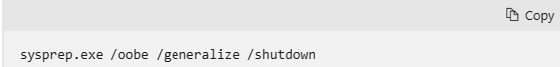
Before creating an image
Remove machine specific information by deprovisioning or generalizing a VM before creating an image.
Windows process:
Sign-in to your Windows VM.
Open a Command Prompt window as an administrator.
Delete the panther directory (C:\Windows\Panther).
Verify if CD/DVD-ROM is enabled. If it is disabled, the Windows VM will be stuck at out-of-box experience (OOBE).
Then change the directory to %windir%\system32\sysprep, and then run:
The VM will shut down when Sysprep is finished generalizing the VM. Do not restart the VM. Once Sysprep has finished, set the status of the virtual machine to Generalized.
Notes:
Deprovision or generalize a VM before creating an image - Azure Virtual Machines | Microsoft Learn
Speaker’s Notes:

Slide 5
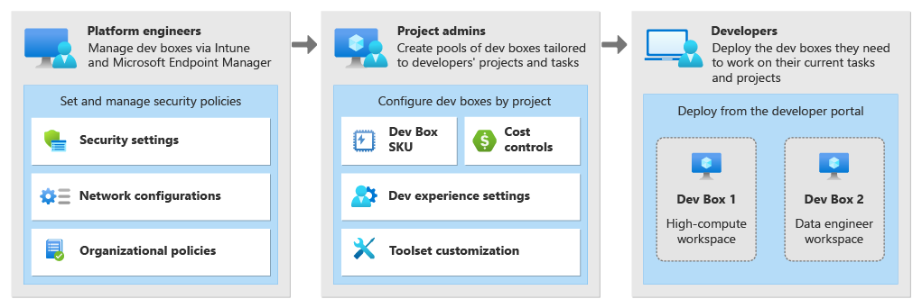
Organizational roles
The Dev Box service was designed with three organizational roles in mind: platform engineers, developer team leads, and developers.
Notes:
What is Microsoft Dev Box? - Microsoft Dev Box | Microsoft Learn
Speaker’s Notes:

Slide 6
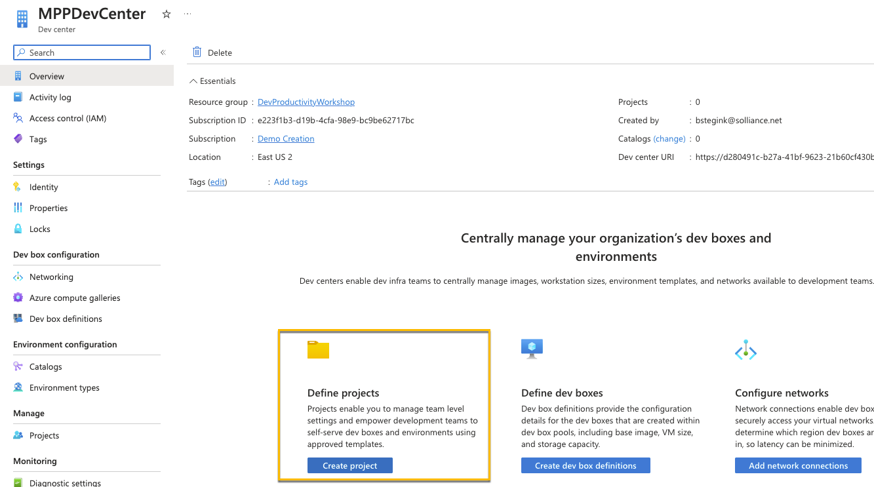
Reasons for having a separate Dev Portal
Notes:
Quickstart: Create a dev box - Microsoft Dev Box | Microsoft Learn
Configure a managed identity - Azure Deployment Environments | Microsoft Learn
Speaker’s Notes:
A separate Developer Portal, often referred to as a Developer Center, serves as a dedicated, centralized platform aimed at supporting developers in understanding, utilizing, and integrate with an organization's APIs, tools, and resources.
After you create the dev box, you can connect to it with a Remote Desktop session through a browser or through a Remote Desktop app.
Microsoft Dev Box enables you to create cloud-hosted developer workstations in a self-service way. You can create and manage dev boxes by using the developer portal.
Depending on the project configuration and your permissions, you have access to different projects and associated dev box configurations.

Slide 7

GitHub Copilot
AI pair programmer built to help developers rediscover the joy and creativity of coding.
Notes:
GitHub Copilot for Business - Home (sharepoint.com)
Seller Tools (sharepoint.com)
Speaker’s Notes:

Slide 8




Give your developers a huge advantage
Increase developer productivity
And satisfaction by focusing on real problems
Accelerate innovation
Prototype & innovate more rapidly
Bridge skill gaps
Learn new languages and techniques
Notes:
Speaker’s notes:
Alternate titles: Give Your Developers the Advantage of AI
GitHub Copilot improves developer productivity and happiness, reducing disruptions, improving flow and increasing the amount of time a developer spends doing satisfying work.
Accelerate Software Development & Delivery & Improve Organization Efficiency
Increase developer productivity and satisfaction: Copilot supports developer satisfaction and thus productivity by helping them focus on solving real problems. By providing suggestions and boiler-plate code, developers can cut down on development time and create more consistent code. Adopting GitHub Copilot has secondary effects on improving job satisfaction, improving retention.
Accelerate Innovation: Using Copilot, teams can prototype new ideas more rapidly and innovate faster. As an additional benefit, companies that adopt the latest technologies can attract new talent by investing in the best-in-class tools as they seek to modernize their development processes.
Bridge skill gaps: GitHub Copilot helps professionals learn and practice new languages faster. For employers in demand of talented developers with niche programming skills (like COBOL), GitHub Copilot can help companies train and grow employees with those skills faster.

Slide 9

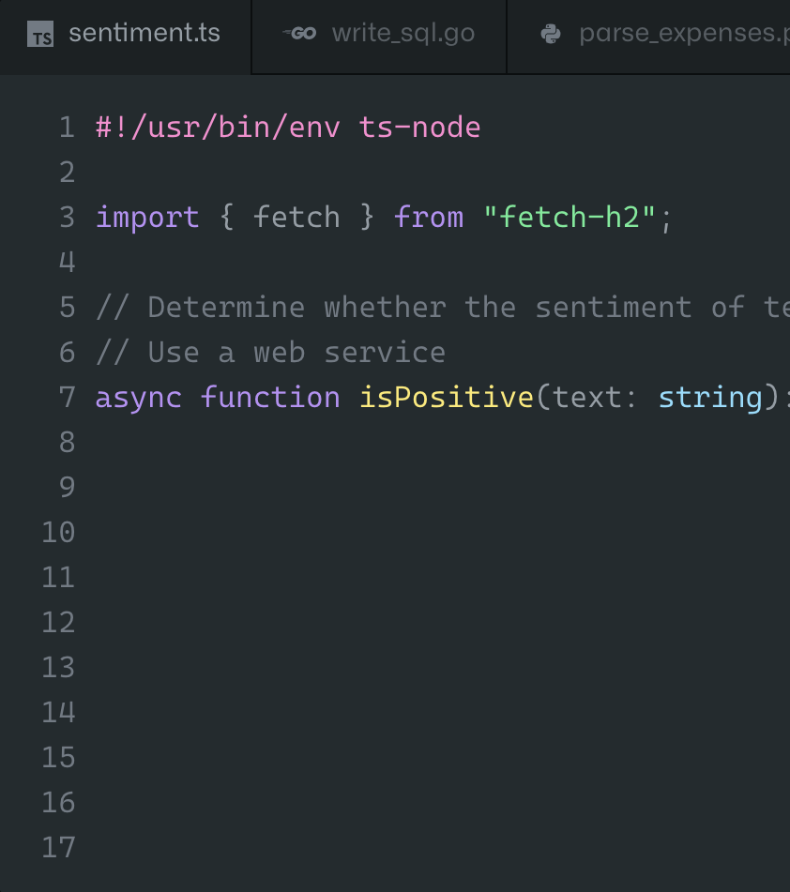
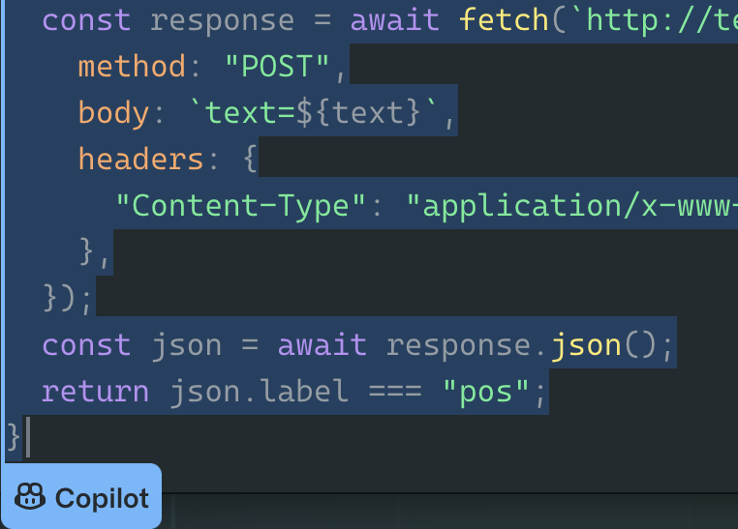
Offers code suggestions, contextualized to your project
Convert comments to code
Autofill for repetitive code
Show alternatives
Notes:
Speaker’s notes:
Uses the context you’ve provided and synthesizes code to match
Convert comments to code: describe the logic you want, and let GitHub Copilot assemble the code for you
Autofill for repetitive code: quickly produces boilerplate and fills in repetitive code patterns
Show alternatives: show a list of solutions to use as provided, or edit to meet your needs

Slide 10
Keep flying with your favorite editor
VS Code
GitHub Codespaces
Visual Studio (Windows)
JetBrains IDEs
Neovim
Notes:
Speaker’s notes:
GitHub Copilot is available where you want it. On your desktop using popular IDEs or in your browser using GitHub Codespaces.

Slide 11
How to configure GitHub Copilot
Exercise three Improve and deploy your application
Task one Configure Microsoft Copilot on your Dev Box
In this task, you will ensure that your Dev Box has GitHub Copilot installed and that GitHub Copilot is able to make recommendations for C# code.
Ensure that you have GitHub Copilot access associated with your GitHub account.
Sign up for GitHub Copilot as a Microsoft employee if you have not done so already.
It is strongly recommended that you invite your personal GitHub account at the end of the process linked above and use this account for the following steps.
Install the GitHub Copilot extension for Visual Studio Code.
Log in with your user account.
Open the GitHub Copilot completions panel.
Use Copilot in a sample project to ensure it is working.
For example: you can type a comment in a C# file asking the copilot to create a loop from 1 to 10.
Notes:
TechExcel-Implementing-DevOps-practices-to-accelerate-developer-productivity/CODE_OF_CONDUCT.md at main · microsoft/TechExcel-Implementing-DevOps-practices-to-accelerate-developer-productivity (github.com)
Speaker’s Notes:

Slide 12
Exercise two
Start working in GitHub

Slide 13











GitHub Enterprise Single, integrated platform that empowers
developers
build
code
test
plan
release
monitor
deploy
operate
Notes:
GitHub Enterprise Pitch Deck.pptx (sharepoint.com)

Slide 14












GitHub Enterprise
Fully integrated DevSecOps Platform
Collaboration & innersourcing
Granular
permissions
& custom roles
Open Source Access
Private packaging & container registry
Project planning
Automation & development tools
Actions
Codespaces
Config-as-code
GitHub copilot
Secure by design
SAML SSO & SCIM
Code scanning & variant analysis
Secret scanning
Security overview
Notes:
Speaker’s notes:
GitHub Enterprise Pitch Deck.pptx (sharepoint.com)
How We Do it Better
(tie back to 3 opportunities)
GitHub provides an end-to-end, centralized platform that accelerates high-quality software development
and delivery – Collaboration and innersourcing
● Empower developers to build productively
● Consolidate and scale as your teams and requirements grow
● Collaborate across teams
● Provide a secure, compliant platform without sacrificing speed
● Access to cutting-edge innovation and industry leadership
Empower developers to build productively – Collaboration and innersourcing
o Most developers learn to code on GitHub, they are familiar with GitHub and love the GitHub flow
o Single, intuitive platform with purposeful UI/UX for uninterrupted developer experience
o Instant pre-configured development environment shortens time-to-productivity
o 10k+ community-generated reusable workflows created and increasing daily
o Be the first to benefit from the innovation that stems within the open source community
Consolidate and scale as your teams and requirements grow – Automation and development tools
o Extended and advanced git and architecture to meet the needs of the world’s largest teams
o Benefit from the lessons learned from hosting the world’s largest git community
o Architecture, complete capabilities, and deployment flexibility to support growing teams
o Scalable platform and permission structure that supports global deployments
Collaborate across teams – Collaboration and innersourcing
o Bring developers and non-developers together to collaborate on the same platform and workflow
o Benefit from the collaboration best practices from hosting the world’s largest open source community
o Enterprise collaboration from anywhere (Mobile access, Codespaces and web)
o Single, intuitive platform with purposeful UI/UX for uninterrupted developer experience, optimized to
support collaboration
Provide a secure, compliant platform without sacrificing speed - Secure by design
o Customizable branch protection rules, auditable reviews, granular access and multiple reviewers to
provide total control for the code base
o Enterprise grade logging and access control capabilities that satisfy security and compliance
requirements
o Multiple deployment options

Slide 15
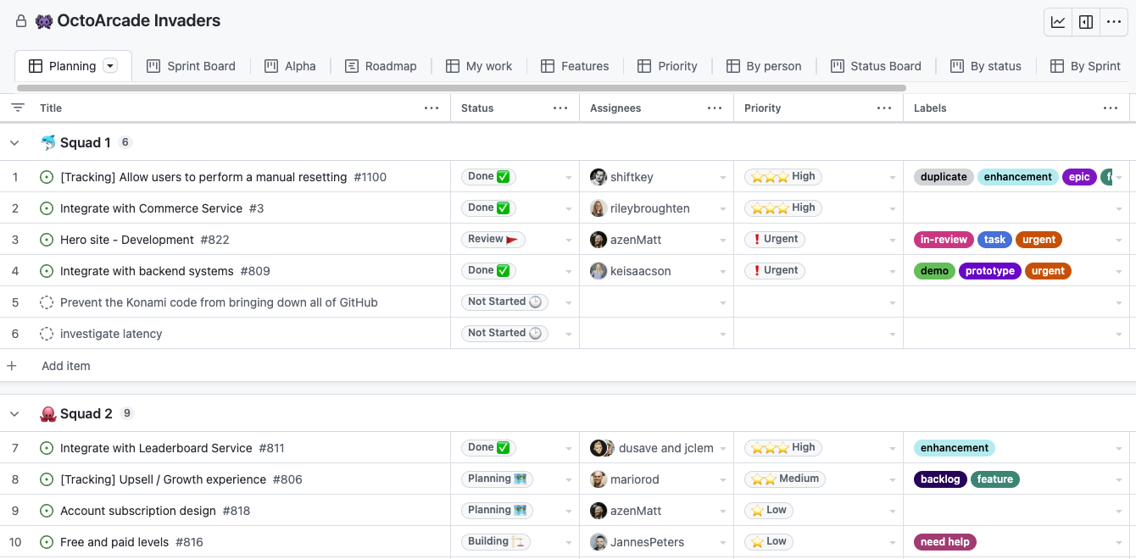
GitHub project – table layout
Notes:
About Projects - GitHub Docs
Speaker’s Notes:
Projects is an adaptable, flexible tool for planning and tracking work on GitHub.
A project is an adaptable spreadsheet, task-board, and road map that integrates with your issues and pull requests on GitHub to help you plan and track your work effectively.
You can create and customize multiple views by filtering, sorting, grouping your issues and pull requests, visualize work with configurable charts, and add custom fields to track metadata specific to your team.
Rather than enforcing a specific methodology, a project provides flexible features you can customize to your team’s needs and processes.
SAY:
The table layout is a powerful and adaptable spreadsheet comprised of your issues, pull requests, and draft issues with metadata from GitHub and the custom fields you've added to your project. You can group, sort, and filter items, and show or hide fields in your table layouts to suit the needs of everyone on your team. For more information, see "Customizing the table layout."

Slide 16
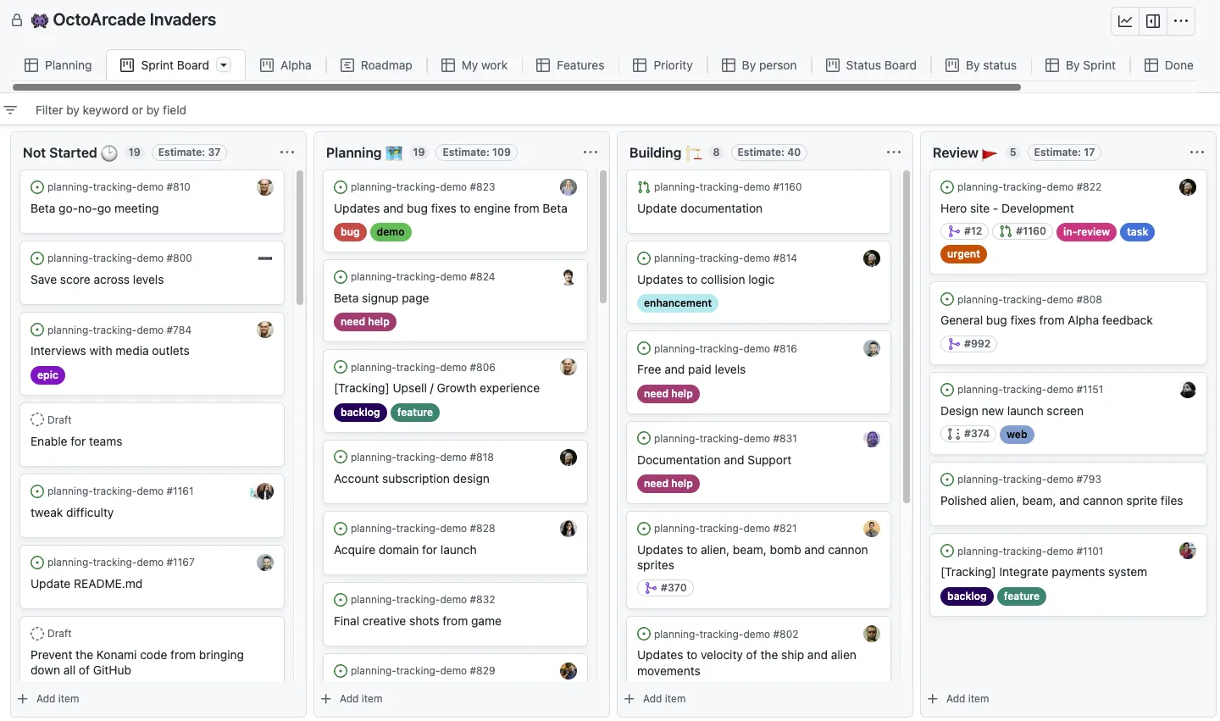
GitHub project – board layout
Notes:
About Projects - GitHub Docs
Speaker’s Notes:
SAY:
The board layout spreads your issues, pull requests, and draft issues across customizable columns. You can create a kanban board by setting your column field to a "Status" field or set any other single select or iteration field as the column field.
You can drag individual or multiple items from column to column and the value of those items will adjust to match the column you drag them to. For more information, see "Customizing the board layout."

Slide 17
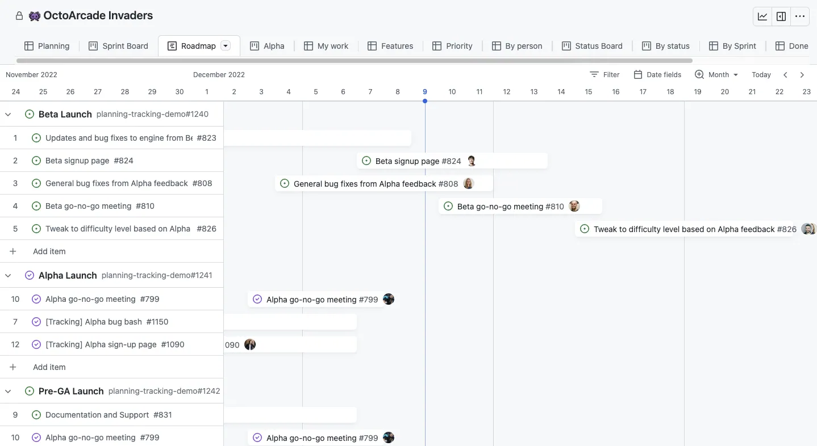
GitHub project – roadmap layout
Notes:
About Projects - GitHub Docs
Speaker’s Notes:
SAY:
The roadmap layout provides a high-level visualization of your project across a configurable timespan, and allows you to drag items to affect their start and target dates or selected iteration. Roadmaps use your custom date and iteration fields to position your issues, pull requests, and draft issues on a timeline, allowing you to track work over time and watch progress.
You can also display vertical lines to highlight key dates for your project, including iterations, milestones, and the dates of items in your project. These markers help you get a clear overview of your upcoming workload and how it's distributed across iterations or milestones. For more information, see "Customizing the roadmap layout."

Slide 18



Exercise two architecture
Your GitHub repository
GitHub Project board
Application
Issues
Issue 1 – Done
Issue 2 - New
Issue 3 - New
Issue 4 - New
Issue 5 - New
InfrastructureAsCode
Clone
.github
Lab
GitHub repository
workflows
first-workflow.yml
Notes:
Speaker’s notes:
SAY:
This exercise will focus on cloning the code repository into your environment, configuring a GitHub project and project board, and creating a GitHub Actions workflow.

Slide 19
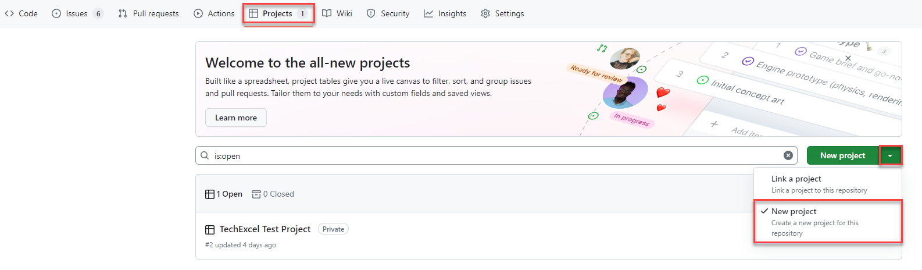
GitHub project
Notes:
Speaker’s notes:
SAY:
GitHub Projects allow development teams and project managers to manage issues, using either a scrum or kanban motif.

Slide 20
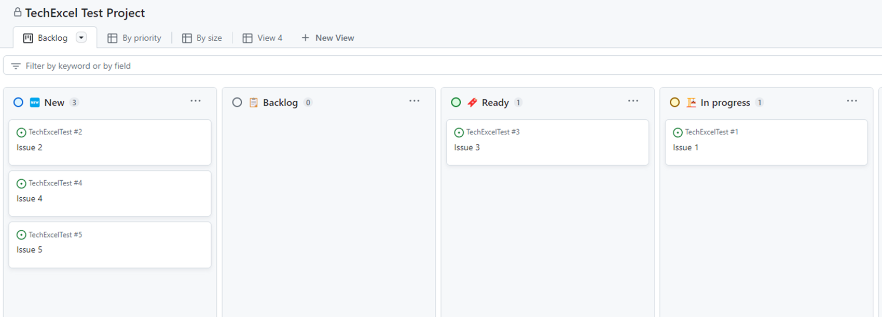
Navigate the project board
Notes:
Speaker’s notes:
SAY:
You will create a series of issues on a project board and see how you can manipulate the board to keep track of the status of issues. You will assign issues to teammates and add a custom field to issues.

Slide 21
GitHub workflow with annotations
# The name of the job is what will display on the GitHub repository in the Actions tab.
name: First Workflow
# The 'on' section tells GitHub under what conditions we want to run this workflow.
# https://docs.github.com/en/actions/using-workflows/events-that-trigger-workflows
# Common scenarios include:
# workflow-dispatch (manual execution)
# issues
# push
# pull_request
# schedule
on:
workflow_dispatch:
issues:
types: [opened]
# This section covers the work to perform.
# We include one or more jobs in this section.
Notes:
Speaker’s notes:
Comment from Daniel: It might be worth showing an example of the solution GitHub workflow from the Coach material and annotating it with the various different sections of a workflow covering
Variables
Tasks
Expressions
etc.

Slide 22
GitHub workflow
job1:
# We can run jobs on GitHub hosted VM runners in Windows, Ubuntu, and Mac OS.
# We can also run jobs on self-hosted hardware.
runs-on: ubuntu-latest
# Each job contains one or more steps. A step needs to have at least a name and a command.
steps:
- name: Step one
# The 'run' command executes a shell or command script. Because this is Ubuntu, the
# default run command will be /bin/bash
run: echo "Log from step one"
# This section does not appear in the solution file but demonstrates how to set
# custom variables that will be available in the run script.
env:
VARIABLE_NAME: value
- name: Step two
run: echo "Log from step two"

Slide 23
GitHub workflow
job2:
# Job 2 will only run after job 1 completes.
# Removing this 'needs' section would make the jobs run simultaneously.
needs: job1
runs-on: ubuntu-latest
steps:
- name: Cowsays
# The 'uses' command executes a remote GitHub action.
# A command like mscoutermarsh/cowsays-action means you can
# find this code at https://github.com/mscoutermarsh/cowsays-action
uses: mscoutermarsh/cowsays-action@master
# The 'with' block includes parameters that the workflow will pass
# to this action. Parameters are all in key-value format.
with:
text: 'Ready for prod--ship it!'
color: 'magenta'

Slide 24
Exercise three
Improve and deploy your application

Slide 25
Bicep template
GitHub allows users to execute ARM and Bicep templates as part of a GitHub Actions workflow
To deploy resources, you will need to log into Azure and then use the arm-deploy action.
- uses: azure/login@v1
with:
creds: ${{ secrets.AZURE_CREDENTIALS }}
- name: Run ARM deploy
uses: azure/arm-deploy@v1
with:
subscriptionId: ${{ secrets.AZURE_SUBSCRIPTION_ID }}
resourceGroupName: ${{ secrets.AZURE_RG }}
template: ./InfrastructureAsCode/main.bicep
parameters: environment=${{ github.event.inputs.appenv }}
The action above will deploy a file called main.bicep to Azure whenever the GitHub Actions workflow runs.
Notes:
Speaker’s notes:

Slide 26
Exercise one: set up development environment
Notes:
Speaker’s notes:
Display the slide to signal the start of Exercise 1.

Slide 27
Introductions: set up development environment
In this exercise, you’ll setup a development environment
After completing this exercise, you’ll be able to:
Deploy the necessary infrastructure for an Azure Dev Box.
Create an image for your Dev Box.
Create a Dev Box.
Grant users permissions to create and access their Dev Box.
Configure GitHub Copilot and use it to assist with several activities.
Notes:
Speaker notes:
SAY:
To start of this series of labs, you need a box with the appropriate software and configuration to be able to perform various development activities.
This exercise will guide you through all the steps necessarily to be able to setup and configure Dev Box in Azure the way the architecture was defined. You’ll be able to use that Dev Box to perform that various development activites through the rest of this training and have the software pre-installed in the custom image you’ll create.
In this exercise, you’ll create Dev Box, create a custom image, assign that image to Dev Box and create a Dev Box to be used for the training.
Learning objectives
After completing this exercise, you'll be able to:
Setup the Azure Dev Box Service
Create a VM that can be used to configure a custom image to be used in Dev Box
Assign that custom image to a Dev Box definition and subsequent Dev Pool
Configure permissions so users an create and login to their dev box

Slide 28
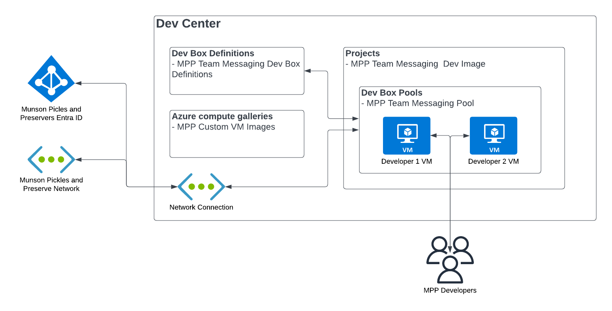
Exercise one architecture
Azure Dev Box
Notes:
Speaker’s Notes:
SAY:
The exercise will focus on creating a custom Dev Box setup for Munson’s Pickles and Preserves
Exercise 01: Set up the development environment
For Dev Box, most of the configuration aspects of it are contained with the Dev Center service in Azure. The only two things that really need to live outside of it are the network you wan the dev boxes to connect to as well as either Active Directory or Entra ID (Azure AD) for user authentication. In our case, we’ll just create a basic network to connect to, but in a customer scenario, this could be their corporate network or the network all the development servers are on, or any other network they’ve created with resourced needed by the Developers. For Authentication, Active Directory or Microsoft Entra ID can be used. Most enterprise customer will probably still have AD they may want to use, but again for simplicity in this exercise, we’ll just use Microsoft Entra ID.
The only other thing that you may need to do outside of Dev Center is if you need a custom image like we’ll create in this exercise. If you just want to use one of the Microsoft Provide images, you can create a Dev Box from a standard Image as well.
Within Dev Center, there are several components:
- Dev Box Definitions: These are just custom images you’ve created and defined to be used within the Dev Center.
- Azure computer galleries: This as the galleries in Azure that hold the custom images used to create your Dev Box Definitions.
- Network Connection: Within Dev Center, you need to specify a network connection that you will use to connect the VMs in Dev Center to a network of your choosing.
- Projects: Projects are the particular development project a dev box belongs to. This enables you to even setup permissions at the project level so someone outside of “normal” Azure administration could define dev box and setup permissions for developers to be able to login and use Dev Box
- Dev Box Pools: This is a virtual machine pool. Each pool is assigned a dev box definition. Developers can be assigned to one or more pools. The developer can then create and access a Virtual Machine within that pool to perform their development activities. Administrators can see how many virtual machines have been created in each pool.

Slide 29
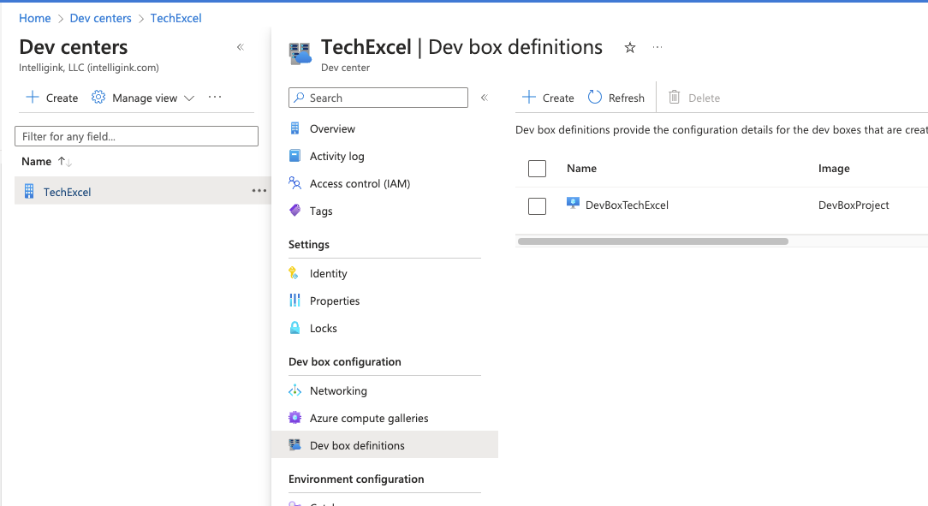
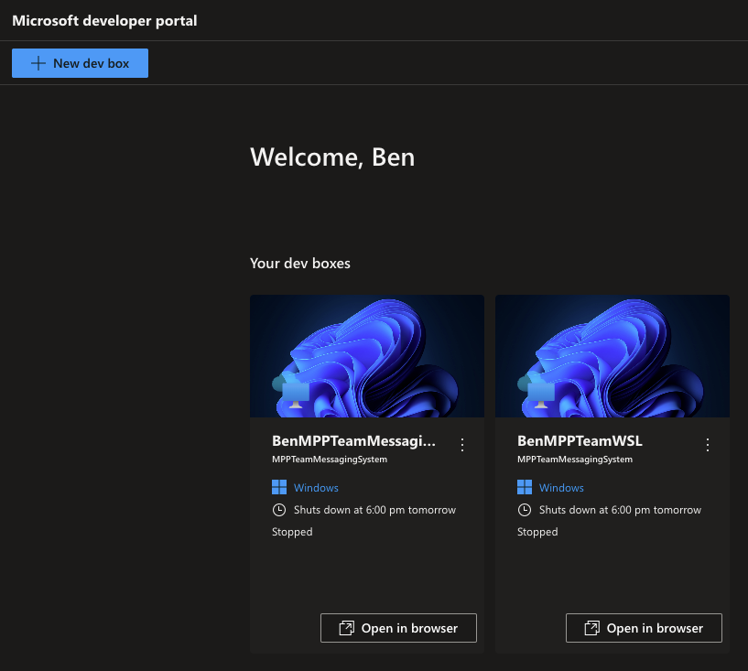
Create a Dev Box definition
Notes:
Speaker notes:
SAY:
Azure Dev Box enable you to create multiple Dev Box configurations/definitions within Azure. This provides a couple advantages. First, you can create a standard image so you know all your developers are starting on a common framework with the same software and versions of the software installed. Since you can also create multiple definitions, you can have separate denifitions for all of your products. If a developers needs to switch between projects they are developing, they can easily spin up and switch between VMs. This isolates the environments from each other, so developers are worried about effecting their configuration for one development project when when working on a second development projects.
Using Dev Box, also creates a secure way to connect to the virtual machine as it uses the Azure Virtual Desktop infrastructure under the covers. So rather than connecting to a development machine over RDP, they can use the browser or the Remote Desktop client to connect to a Dev Box workspaces associated with their corporate account too remotely connect to the dev box to perform their activities.

Slide 30
Exercise one summary Set up development environment
In this exercise you:
Deployed Microsoft DevBox infrastructure for DevBox.
Created an image for your DevBox.
Created a DevBox.
Granted users permissions to create and access their DevBox.
Installed the GitHub Copilot extension for Visual Studio Code.
Notes:
Speaker’s Notes:
After the team completes exercise 1, briefly go through the list of tasks covered in the exercise as a form of review.
Inform the group that no debrief will be conducted for exercise 1, as a combined debrief will be done for both exercises 1 and 2 at the end of exercise 2.

Slide 31
Exercise two: start working in GitHub
Notes:
Speaker’s notes:
Display the slide to signal the start of Exercise 2.

Slide 32
Introductions: start working in GitHub
In this exercise, you’ll begin by creating a GitHub repository. From there, you will create a GitHub Project and associate issues with that project. Finally, you will create a simple GitHub Actions workflow.
After completing this exercise, you’ll be able to:
Create a GitHub repository.
Create a GitHub Project.
Assign issues to teammates and navigate a project board.
Add custom fields to issues.
Create a GitHub Actions workflow.
Extend a GitHub Actions workflow with multiple jobs.
Incorporate workflow actions from the GitHub Marketplace.
Notes:
Speaker notes:
SAY:
In the previous exercise, you created a Dev Box to perform development work.
In this exercise, you will create a GitHub repository and work through some of the mechanics of GitOps, including project board management, issue management, and the creation of a GitHub Actions workflow.
Learning objectives
After completing this exercise, you'll be able to:
Create a GitHub repository
Create a GitHub Project
Assign issues to teammates and navigate a project board
Add custom fields to issues
Create a GitHub Actions workflow
Extend a GitHub Actions workflow with multiple jobs
Incorporate workflow actions from the GitHub Marketplace
Speaker’s Notes:
Inform Students that the instructions for completing the exercises are in the GitHub link TBD.
Proceed with the exercise.

Slide 33
Exercise two architecture
Your GitHub repository
GitHub Project board
Application
Issues
Issue 1 – Done
Issue 2 - New
Issue 3 - New
Issue 4 - New
Issue 5 - New
InfrastructureAsCode
Clone
.github
Lab
GitHub repository
workflows
first-workflow.yml
Notes:
Speaker’s notes:
SAY:
This exercise will focus on cloning the code repository into your environment, configuring a GitHub project and project board, and creating a GitHub Actions workflow.

Slide 34
Create a GitHub project
Notes:
Speaker notes:
SAY:
GitHub Projects allow development teams and project managers to manage issues, using either a scrum or kanban motif.

Slide 35
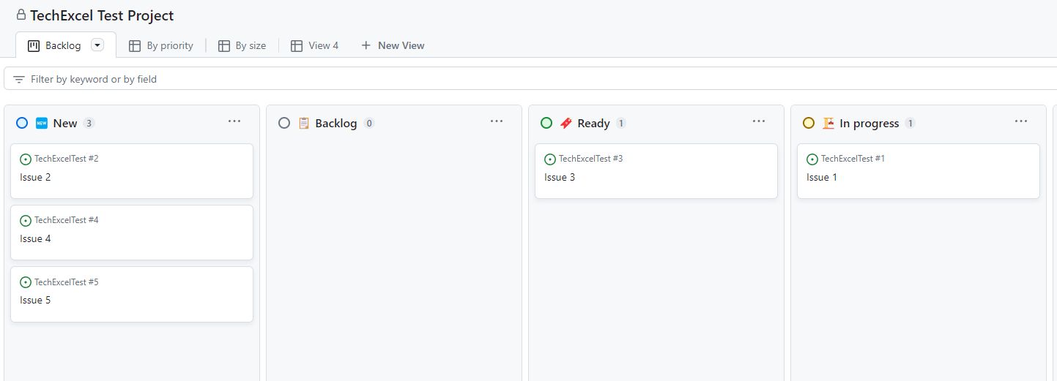
Navigate the project board
Notes:
Speaker notes:
SAY:
You will create a series of issues on a project board and see how you can manipulate the board to keep track of the status of issues. You will assign issues to teammates and add a custom field to issues.

Slide 36
Create a GitHub actions workflow
You’ll create the first of several GitHub Actions workflows.
name: First Workflow
on:
workflow_dispatch:
issues:
types: [opened]
jobs:
job1:
runs-on: ubuntu-latest
steps:
- name: Step one
run: echo "Log from step one"
- name: Step two
run: echo "Log from step two"
job2:
needs: job1
runs-on: ubuntu-latest
steps:
- name: Cowsays
uses: mscoutermarsh/cowsays-action@master
with:
text: 'Ready for prod--ship it!'
color: 'magenta'
Allow the workflow to run manually.
Each workflow has one or more jobs. We will create two jobs.
Each workflow job has one or more steps.
You’ll include the cowsays action from the GitHub Marketplace.
Notes:
Speaker notes:
SAY:
GitHub Actions workflows allow you to perform actions on specific events, such as push code into a branch, creating a pull request, creating an issue, or manual execution.
For this first workflow, you will create a workflow which executes manually. In it, there will be two jobs. The first job will write statements into logs. The second will use the “cowsays” action from the GitHub Marketplace to write a statement into the logs.

Slide 37
Exercise two summary Start working in GitHub
In this exercise you:
Created a GitHub repository.
Created a GitHub project.
Assigned issues to teammates and navigated through a project board.
Added custom fields to issues.
Created a GitHub Actions workflow.
Extended a GitHub Actions workflow with multiple jobs.
Incorporated workflow actions from the GitHub Marketplace.
Notes:
Speaker’s Notes:
After the team completes exercise 2, briefly go through the list of tasks covered in the exercise as a form of review.

Slide 38


Debrief exercises one and two
Reflection and discussion points
Share what you learned and any challenges you faced.
What did you find valuable or interesting?
Share your insights, experiences, and any questions you might have.
Think about how the exercise content can be applied to real-world scenarios or your work. Share any relevant insights.
If there's something you didn't understand or if you're curious about a particular aspect of the exercise, feel free to ask questions. Debrief sessions are meant for clarification and learning.
If you have ideas for improving the exercise or applying the concepts differently, don't hesitate to share your suggestions.
Notes:
Speaker’s Notes:
These questions are available in the Student’s guide as well.
If you are short on time, have Students select one reflection or discussion point they would like to answer.

Slide 39
Exercise three: improve and deploy your application
Notes:
Speaker’s notes:
Display the slide to signal the start of Exercise 3.
Inform Students that only the first two tasks in Exercise 3 will be completed in Day 1. The remaining two tasks will be completed in Day 2.
Exercise 3 will be debriefed when Exercise 3 is completed.

Slide 40
Introductions: improve and deploy your application
In this exercise, you’ll deploy Azure resources and introduce CI/CD pipelines to your GitHub repo.
After completing this exercise, you’ll be able to:
Deploy ARM and Bicep templates via GitHub Actions workflow.
Create a GitHub Actions workflow for deploying .NET web applications.
Automatically build and deploy a Docker image as part of a workflow.
Update an Azure Web App whenever the GitHub Actions workflow deploys a new Docker image.
Notes:
Speaker notes:
SAY:
You've created a GitHub repository containing application code and a Bicep script. In this exercise, you will create resources in an Azure resource group, including an App Service Plan, three App Services, one Application Insights service, and one Container Registry. You will also use GitHub Copilot in Visual Studio Code to assist you with making a change to the Team Messaging System.
After deploying Azure resources, you will create a new GitHub Actions workflow that builds and deploys a Docker container image based on the .NET web application code. Then, whenever the application code changes, you will build a new image, deploy it to the Container Registry, and use that new image in your App Services.
Learning objectives
After completing this exercise, you'll be able to:
Configure GitHub Copilot and use it to assist with C# code changes
Deploy ARM and Bicep templates via GitHub Actions workflow
Create a GitHub Actions workflow for deploying .NET web applications
Automatically build and deploy a Docker image as part of the workflow
Update an Azure Web App whenever the GitHub Actions workflow deploys a new Docker image
Speaker’s Notes:
Inform Students that the instructions for completing the exercises are in the GitHub link TBD.
Proceed with the exercise.

Slide 41
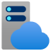



Exercise three architecture
Munson’s Pickles & Preserves application architecture
App Service Plan
App Insights
App Service (Dev)
App Service (Test)
App Service (Prod)
Container Registry
Notes:
Speaker’s notes:
SAY:
This exercise will focus on deploying the Munson’s Pickles and Preserves Team Messaging System application into Azure.

Slide 42
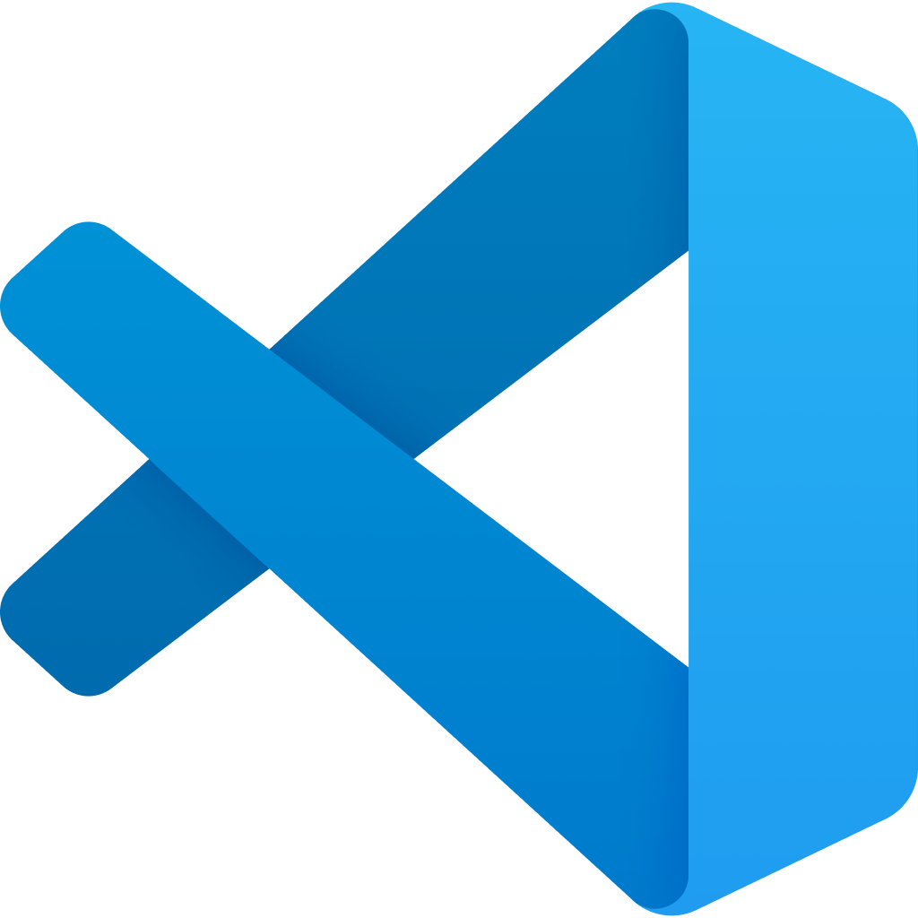
Follow the GitHub flow
The GitHub Flow is a common process for managing code changes through GitHub.
Create a GitHub Issue
Create a feature branch
Fetch repo changes locally
VS Code
Commit and push changes
GitHub allows you to tie issues, branches, and pull requests together, letting GitHub close issues and delete feature branches after code moves to the main branch.
Pull request to main
Code review
Complete pull request
Notes:
Speaker notes:
SAY:
The GitHub flow is a standard process for making code changes in a GitHub repository. There are several steps to the GitHub flow:
Create a GitHub Issue describing the problem you would like to solve. This may involve discussion with team members, project managers, issue reporters, and relevant stakeholders. The GitHub Issue should include enough details to prompt a code change.
Create a new branch. This new branch, called a feature branch, will allow you to work on your code independent of other developers. It will also allow you to experiment without breaking important code release branches like a development or main branch.
After creating the new branch, fetch changes locally and switch to the newly created feature branch. At this point, any changes you make locally will be in the feature branch, isolating your changes from others.
Make any necessary changes in tools like Visual Studio Code. If you have correctly configured Visual Studio Code and installed the C# extension, you should be able to run the .NET web application locally and try it out in a browser.
After you have completed all code changes, you can commit these changes locally. Then, when you are ready to complete the task, you can push your changes to the remote feature branch.
After you have pushed your changes, you can create a pull request. In this case, we will pull request directly to the main branch, though some repositories may have a series of branches such as dev, test, and main.
A teammate should perform a code review of the code in your pull request. This allows a second set of eyes to review the code changes and ensure that these are appropriate and correct changes.
After the code review completes, completing the pull request is the final step. In this process, you may wish to delete the feature branch and close the originating issue.
Note:
At the end of Exercise 3, task 2
SAY:
We will continue with Exercise 3 tomorrow to finish tasks 3 and 4.

